Slide 1
Operational Transformation

Slide 2
Why collaborative editor?
Collaborative editing is a process of writing and editing documents or projects by more than one person.

Slide 3
Continued…

Slide 4
Challenges of collaborative editor
Consistency maintenance in the face of concurrent accesses to shared object is one of the core issues in the design of these types of systems.
Concurrency control.
Network latency

Slide 5
Methods to solve Ce problem
Simple Locking
Optimistic Locking
Operational transformation

Slide 6
What is Operational Transformation
OT is an optimistic consistency control method in collaborative editing system or groupware.
OT algorithm is used to transform the remote operation (insertion, deletion) with respect to locally performed independent operations and updates the transformed remote operation on the local document.

Slide 7
Properties of Operational transformation
Causality preservation: ensures the execution order of causally dependent operations be the same as their natural cause-effect order during the process of collaboration.
Convergence: ensures the replicated copies of the shared document be identical at all sites.
Intention preservation: ensures that the effect of executing an operation on any document state be the same as the intention of the operation.

Slide 8
Transformation functions
There are two types of Transformation Function:
Inclusion Transformation: denoted as IT(a, b), which transforms Operation a against another operation b in such a way that the impact of b is effectively included.
Exclusion Transformation: denoted as ET(a, b), which transforms Operation a against another operation b in such a way that the impact of b is effectively excluded.

Slide 9

Cases of inclusion transformation function
$Case 1: T_{1}$(ins($p_{1}$, $c_{1}$), ins($p_{2}$, $c_{2}$))
Case 2: $T_{2}$(ins($p_{1}$, $c_{1}$), del($p_{2}$))
Case 3: $T_{3}$(del($p_{1}$), ins($p_{2}$, $c_{2}$))
Case 4: $T_{4}$(del($p_{1}$), del($p_{2}$))

Slide 10
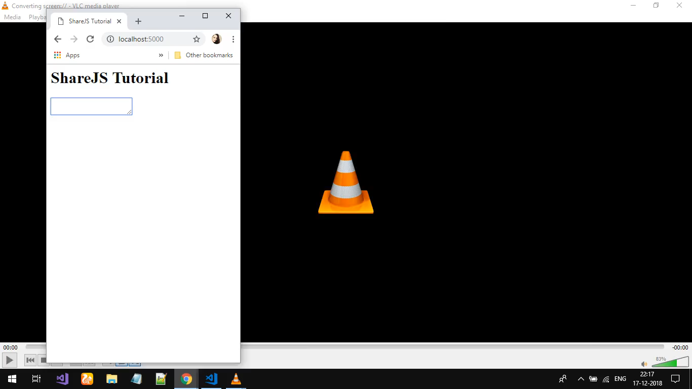
Demonstration sample

Slide 11
Conclusion
Operational Transformation is a very powerful tool that allows building great collaborative apps with support for non-blocking concurrent editing. It ensures the Convergences, it ensures the intention preservation and it ensures the causality preservation.

